Slide 1


Chapter 3: Transport Layer
Computer Networking: A Top-Down Approach 6th edition Jim Kurose, Keith Ross Addison-Wesley

Slide 2
Chapter 3: Transport Layer
Our goals:
understand principles behind transport layer services:
multiplexing/demultipl exing
reliable data transfer
flow control
congestion control
learn about transport layer protocols in the Internet:
UDP: connectionless transport
TCP: connection-oriented transport
TCP congestion control

Slide 3
Chapter 3 outline
Transport-layer services
Multiplexing and demultiplexing
Connectionless transport: UDP
Principles of reliable
data transfer
Connection-oriented transport: TCP
segment structure
reliable data transfer
flow control
connection management

Slide 4


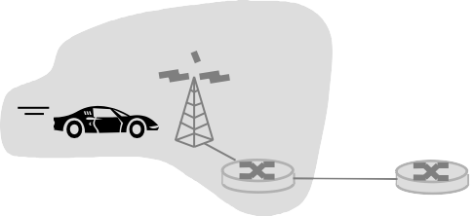






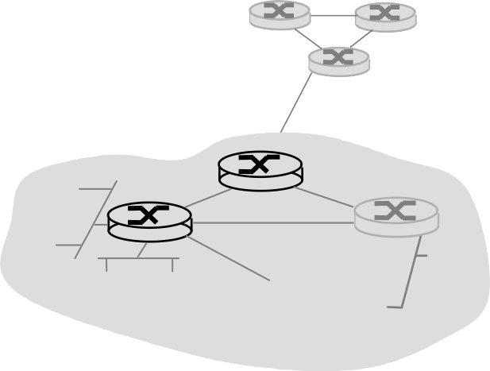





Transport services and protocols
application
transport
network
data link
physical
provide logical communication between app processes running on different hosts
transport protocols run in
end systems
send side: breaks app messages into segments, passes to network layer
rcv side: reassembles segments into messages, passes to app layer
more than one transport protocol available to apps
Internet: TCP and UDP
application
transport
network
data link
physical

Slide 5
Transport vs. network layer
network layer: logical communication between hosts
transport layer: logical communication between processes
relies on, enhances, network layer services

Slide 6
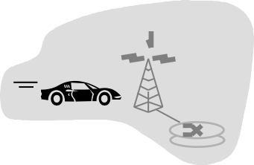

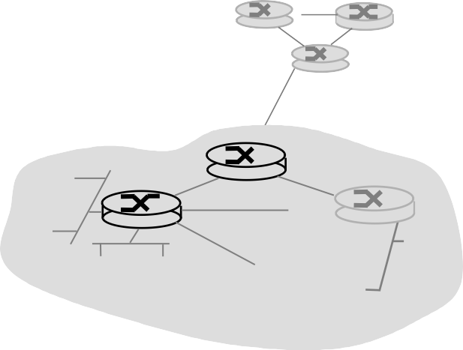
Internet transport-layer protocols
reliable, in-order delivery (TCP)
application
transport network
data link
physical
network
congestion control
flow control
connection setup
data link
physical
network
data link
physical
ne
unreliable, unordered delivery: UDP
network
data link
physical
twork
data link
no-frills extension of
“best-effort” IP
physical
network
data link
application
physical
network
transport network
data link
services not available:
physical
data link
physical
delay guarantees
bandwidth guarantees
Notes:
- Đảm bảo độ trễ
đảm bảo băng thông

Slide 7
Chapter 3 outline
Transport-layer services
Multiplexing and demultiplexing
Connectionless transport: UDP
Principles of reliable
data transfer
Connection-oriented transport: TCP
segment structure
reliable data transfer
flow control
connection management
Principles of congestion control
TCP congestion control

Slide 8

Multiplexing/demultiplexing
multiplexing at sender:
demultiplexing at receiver:
handle data from multiple
sockets, add transport header (later used for demultiplexing)
use header info to deliver
received segments to correct
socket
application
application
P1
P2
application
socket
P3
transport
P4
process
transport
network
transport
network
link
network
link
physical
link
physical
physical

Slide 9
How demultiplexing works
host receives IP
datagrams
each datagram has source IP address, destination IP address
each datagram carries 1 transport-layer segment
each segment has source, destination port number
host uses IP addresses & port numbers to direct segment to appropriate socket
32 bits
source port # | dest port #
other header fields
application data (message)
TCP/UDP segment format

Slide 10
Connectionless demultiplexing
recall: when creating datagram to send into UDP socket, must specify
destination IP address
destination port #
recall: created socket has host-local port #:
DatagramSocket mySocket1 = new DatagramSocket(12534);
when host receives UDP segment:
checks destination port # in segment
directs UDP segment to socket with that port #
IP datagrams with same dest. port #, but different source IP addresses and/or source port numbers will be directed to same socket at dest

Slide 11
Connectionless demux (cont)
DatagramSocket serverSocket = new DatagramSocket
(6428);
DatagramSocket mySocket2 = new DatagramSocket
(9157);
DatagramSocket mySocket1 = new DatagramSocket (5775);
application
application
P1
application
P3
P4
transport
transport
network
transport
network
link
network
link
physical
link
physical
physical
source port: 6428
dest port: 9157
source port: ?
dest port: ?
source port: 9157
dest port: 6428
source port: ?
dest port: ?

Slide 12
Connection-oriented demux
TCP socket identified by 4-tuple:
source IP address
source port number
dest IP address
dest port number
recv host uses all four values to direct segment to appropriate socket
server host may support many simultaneous TCP sockets:
each socket identified by its own 4-tuple
web servers have different sockets for each connecting client
non-persistent HTTP will have different socket for each request

Slide 13
Connection-oriented demux (cont.)
application
application
P4
P5
P6
application
P3
P2
P3
transport
transport
network
transport
network
link
network
link
physical
link
physical
server: IP address B
physical
host: IP address A
source IP,port: B,80
dest IP,port: A,9157
host: IP address C
source IP,port: C,5775
dest IP,port: B,80
source IP,port: A,9157
dest IP, port: B,80
source IP,port: C,9157
dest IP,port: B,80
three segments, all destined to IP address: B,
dest port: 80 are demultiplexed to different sockets

Slide 14
Connection-oriented demux (cont.)
threaded server
application
application
application
P4
P3
P3
P2
transport
transport
network
transport
network
link
network
link
physical
link
physical
server: IP address B
physical
host: IP address A
source IP,port: B,80
dest IP,port: A,9157
host: IP address C
source IP,port: C,5775
dest IP,port: B,80
source IP,port: A,9157
dest IP, port: B,80
source IP,port: C,9157
dest IP,port: B,80

Slide 15
Chapter 3 outline
Transport-layer services
Multiplexing and demultiplexing
Connectionless transport: UDP
Principles of reliable
data transfer
Connection-oriented transport: TCP
segment structure
reliable data transfer
flow control
connection management

Slide 16
UDP: User Datagram Protocol [RFC 768]
“no frills,” “bare bones” Internet transport protocol
“best effort” service, UDP
segments may be:
lost
delivered out of order to app
connectionless:
no handshaking between UDP sender, receiver
each UDP segment handled independently of others
Why is there a UDP?
no connection establishment (which can add delay)
simple: no connection state at sender, receiver
small segment header
no congestion control: UDP can blast away as fast as desired

Slide 17
UDP: more
often used for streaming multimedia
32 bits
source port # | dest port #
length | checksum
Application data (message)
apps
Length, in bytes of UDP
segment, including header
loss tolerant
rate sensitive
other UDP uses
DNS
SNMP
reliable transfer over UDP: add reliability at application layer
UDP segment format
application-specific error recovery!

Slide 18
UDP checksum
Goal: detect “errors” (e.g., flipped bits) in transmitted
segment
Sender:
treat segment contents as sequence of 16-bit integers
checksum: addition (1’s complement sum) of segment contents
sender puts checksum value into UDP checksum field
Receiver:
compute checksum of received segment
check if computed checksum equals checksum field value:
NO - error detected
YES - no error detected. But maybe errors nonetheless? More later
….

Slide 19
Internet Checksum Example
example: add three words 16-bit
1 0110011001100110
1 0101010101010101
0000111100001111
1100101011001010
0011010100110101
sum
checksum
Note: when adding numbers, a carryout from the most significant bit needs to be added to the result

Slide 20
Chapter 3 outline
Transport-layer services
Multiplexing and demultiplexing
Connectionless transport: UDP
Principles of reliable
data transfer
Connection-oriented transport: TCP
segment structure
reliable data transfer
flow control
connection management

Slide 21
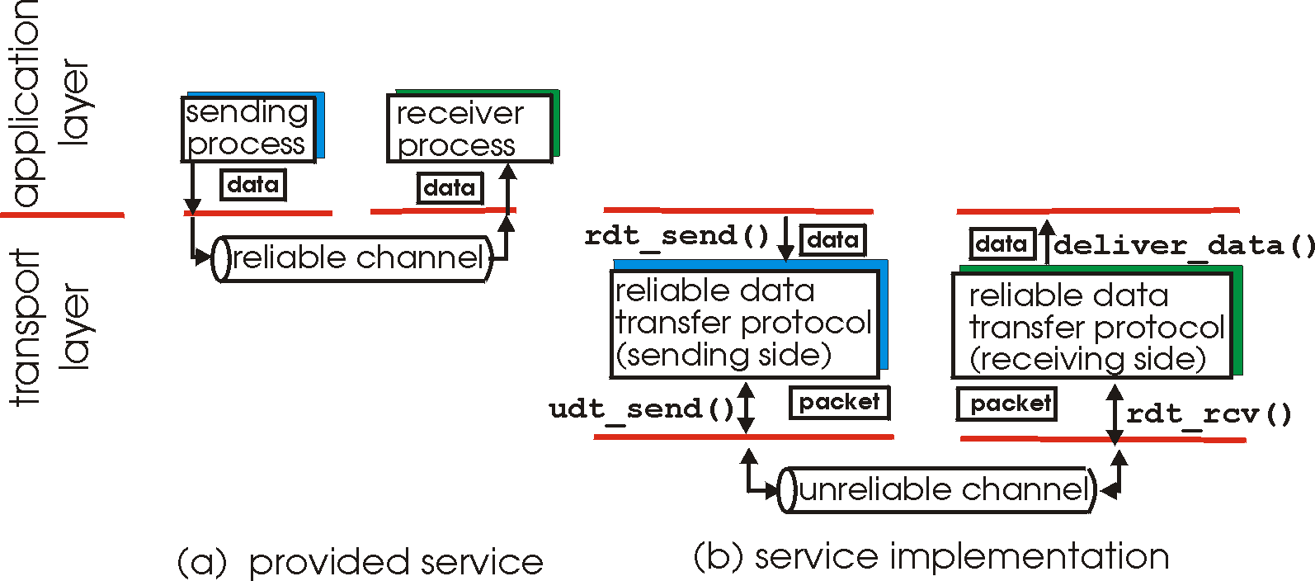
Principles of Reliable data transfer
important in app., transport, link layers
top-10 list of important networking topics!
characteristics of unreliable channel will determine complexity of reliable data transfer protocol (rdt)

Slide 22
Principles of Reliable data transfer
important in app., transport, link layers
top-10 list of important networking topics!
characteristics of unreliable channel will determine complexity of reliable data transfer protocol (rdt)

Slide 23
Principles of Reliable data transfer
important in app., transport, link layers
top-10 list of important networking topics!
characteristics of unreliable channel will determine complexity of reliable data transfer protocol (rdt)

Slide 24
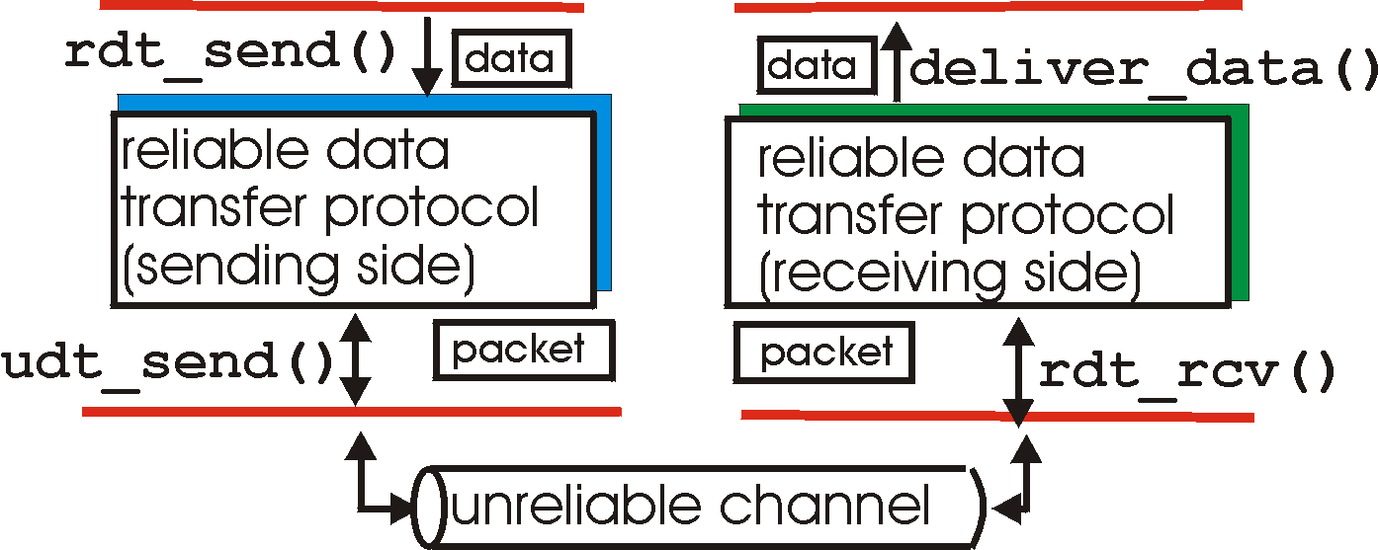
Reliable data transfer: getting started
rdt_send(): called from above, (e.g., by app.). Passed data to
deliver to receiver upper layer
deliver_data(): called by rdt to deliver data to upper
send
side
receive
side
udt_send(): called by rdt,
to transfer packet over
unreliable channel to receiver
rdt_rcv(): called when packet arrives on rcv-side of channel

Slide 25
Reliable data transfer: getting started
We’ll:
incrementally develop sender, receiver sides of reliable data transfer protocol (rdt)
consider only unidirectional data transfer
but control info will flow on both directions!
use finite state machines (FSM) to specify sender, receiver
event causing state transition
actions taken on state transition
state: when in this “state” next state uniquely determined
by next event
state 1
state 2
event
actions

Slide 26
Rdt1.0: reliable transfer over a reliable channel
underlying channel perfectly reliable
no bit errors
no loss of packets
separate FSMs for sender, receiver:
sender sends data into underlying channel
receiver read data from underlying channel
Wait for call from above
rdt_send(data)
Wait for call from below
rdt_rcv(packet)
extract (packet,data) deliver_data(data)
packet = make_pkt(data)
udt_send(packet)
sender
receiver

Slide 27
Rdt2.0: channel with bit errors
underlying channel may flip bits in packet
checksum to detect bit errors
the question: how to recover from errors:
How do humans recover from “errors”
during conversation?
acknowledgements (ACKs): receiver explicitly tells sender that pkt received OK
negative acknowledgements (NAKs): receiver explicitly tells sender that pkt had errors
sender retransmits pkt on receipt of NAK
new mechanisms in rdt2.0 (beyond rdt1.0):
error detection
receiver feedback: control msgs (ACK,NAK) rcvr->sender

Slide 28
Rdt2.0: channel with bit errors
underlying channel may flip bits in packet
checksum to detect bit errors
the question: how to recover from errors:
acknowledgements (ACKs): receiver explicitly tells sender that pkt received OK
negative acknowledgements (NAKs): receiver explicitly tells sender that pkt had errors
sender retransmits pkt on receipt of NAK
new mechanisms in rdt2.0 (beyond rdt1.0):
error detection (checksum)
receiver feedback: control msgs (ACK,NAK) rcvr->sender

Slide 29
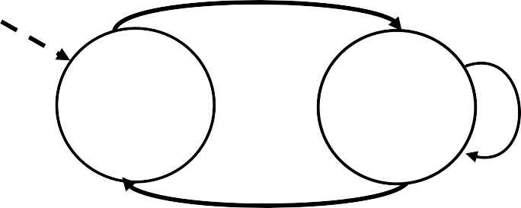
rdt2.0: FSM specification
rdt_send(data)
sndpkt = make_pkt(data, checksum) udt_send(sndpkt)
receiver
rdt_rcv(rcvpkt) && isNAK(rcvpkt)
Wait for call from above
Wait for ACK or NAK
rdt_rcv(rcvpkt) &&
corrupt(rcvpkt)
udt_send(sndpkt)
udt_send(NAK)
rdt_rcv(rcvpkt) && isACK(rcvpkt)
Λ
sender
Wait for call from below
rdt_rcv(rcvpkt) && notcorrupt(rcvpkt)
extract(rcvpkt,data) deliver_data(data) udt_send(ACK)

Slide 30
rdt2.0: operation with no errors
rdt_send(data)
snkpkt = make_pkt(data, checksum)
udt_send(sndpkt)
rdt_rcv(rcvpkt) &&
isNAK(rcvpkt)
Wait for call from above
Wait for ACK or NAK
rdt_rcv(rcvpkt) &&
corrupt(rcvpkt)
udt_send(sndpkt)
udt_send(NAK)
rdt_rcv(rcvpkt) && isACK(rcvpkt)
Wait for call from below
Λ
rdt_rcv(rcvpkt) &&
notcorrupt(rcvpkt)
extract(rcvpkt,data)
deliver_data(data)
udt_send(ACK)

Slide 31
rdt2.0: error scenario
rdt_send(data)
snkpkt = make_pkt(data, checksum)
udt_send(sndpkt)
rdt_rcv(rcvpkt) &&
isNAK(rcvpkt)
Wait for call from above
Wait for ACK or NAK
rdt_rcv(rcvpkt) &&
corrupt(rcvpkt)
udt_send(sndpkt)
udt_send(NAK)
rdt_rcv(rcvpkt) && isACK(rcvpkt)
Wait for call from below
Λ
rdt_rcv(rcvpkt) &&
notcorrupt(rcvpkt)
extract(rcvpkt,data)
deliver_data(data)
udt_send(ACK)
3-30

Slide 32
rdt2.0 has a fatal flaw!
handling duplicates:
sender retransmits current pkt if ACK/NAK corrupted
sender adds sequence number to each pkt
receiver discards (doesn’t deliver up) duplicate pkt
what happens if ACK/NAK corrupted?
sender doesn’t know what happened at receiver!
can’t just retransmit: possible duplicate
stop and wait
sender sends one packet,
then waits for receiver
response

Slide 33
rdt2.1: sender, handles garbled ACK/NAKs
rdt_send(data)
sndpkt = make_pkt(0, data, checksum)
udt_send(sndpkt)
rdt_rcv(rcvpkt) && ( corrupt(rcvpkt) || isNAK(rcvpkt) ) udt_send(sndpkt)
Wait for call 0 from above
Wait for ACK or NAK 0
rdt_rcv(rcvpkt)
&& notcorrupt(rcvpkt)
&& isACK(rcvpkt)
rdt_rcv(rcvpkt)
&& notcorrupt(rcvpkt)
&& isACK(rcvpkt)
Λ
Λ
Wait for ACK or NAK 1
Wait for call 1 from above
rdt_rcv(rcvpkt) && ( corrupt(rcvpkt) || isNAK(rcvpkt) )
rdt_send(data)
sndpkt = make_pkt(1, data, checksum) udt_send(sndpkt)
udt_send(sndpkt)

Slide 34
rdt2.1: receiver, handles garbled ACK/NAKs
rdt_rcv(rcvpkt) && notcorrupt(rcvpkt)
&& has_seq0(rcvpkt)
extract(rcvpkt,data) deliver_data(data)
sndpkt = make_pkt(ACK, chksum) udt_send(sndpkt)
rdt_rcv(rcvpkt) && (corrupt(rcvpkt)
rdt_rcv(rcvpkt) && (corrupt(rcvpkt)
sndpkt = make_pkt(NAK, chksum) udt_send(sndpkt)
sndpkt = make_pkt(NAK, chksum) udt_send(sndpkt)
Wait for 0 from below
Wait for 1 from below
rdt_rcv(rcvpkt) &&
not corrupt(rcvpkt) &&
has_seq1(rcvpkt)
sndpkt = make_pkt(ACK, chksum) udt_send(sndpkt)
rdt_rcv(rcvpkt) &&
not corrupt(rcvpkt) &&
has_seq0(rcvpkt)
sndpkt = make_pkt(ACK, chksum) udt_send(sndpkt)
rdt_rcv(rcvpkt) && notcorrupt(rcvpkt)
&& has_seq1(rcvpkt)
extract(rcvpkt,data)
deliver_data(data)
sndpkt = make_pkt(ACK, chksum) udt_send(sndpkt)

Slide 35
rdt2.1: discussion
Sender:
seq # added to pkt
two seq. #’s (0,1) will
suffice.
must check if received ACK/NAK corrupted
twice as many states
state must “remember” whether “current” pkt has 0 or 1 seq. #
Receiver:
must check if received packet is duplicate
state indicates whether 0 or 1 is expected pkt seq #
note: receiver can not know if its last ACK/NAK received OK at sender

Slide 36
Recap
Rdt Version | Scenario | Features Added
1.0 | No error | Nothing
2.0 | Data Bit Error | Checksum, ACK/NAK
2.1 | Data Bit Error ACK/NAK Bit Error | Checksum, ACK/NAK, Sequence Number
3.0 | What else?

Slide 37
rdt3.0: channels with errors and loss
New assumption: underlying channel can also lose packets (data or ACKs)
checksum, seq. #, ACKs, retransmissions will be of help, but not enough
Approach: sender waits “reasonable” amount of time for ACK
retransmits if no ACK received in this time
if pkt (or ACK) just delayed (not lost):
retransmission will be
duplicate, but use of seq.
#’s already handles this
receiver must specify seq
# of pkt being ACKed
requires countdown timer

Slide 38
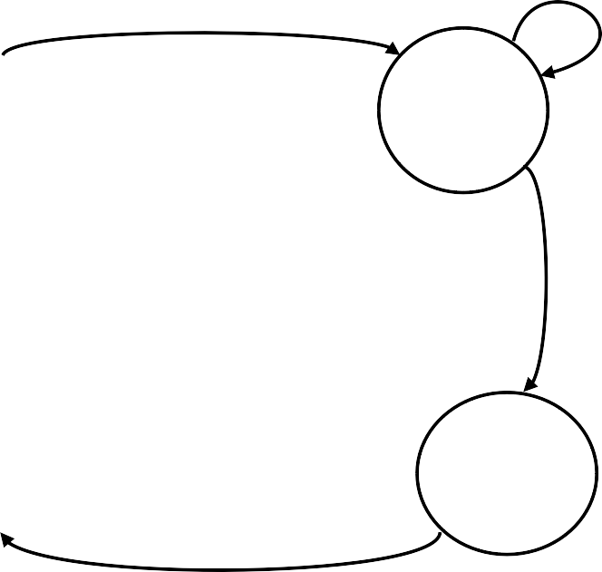
rdt3.0 sender
rdt_send(data)
rdt_rcv(rcvpkt) && ( corrupt(rcvpkt) || isACK(rcvpkt,1) )
sndpkt = make_pkt(0, data, checksum) udt_send(sndpkt)
start_timer
rdt_rcv(rcvpkt)
Λ
Λ
Wait for call 0from above
Wait for ACK0
timeout
udt_send(sndpkt) start_timer
rdt_rcv(rcvpkt)
&& notcorrupt(rcvpkt)
&& isACK(rcvpkt,1)
rdt_rcv(rcvpkt)
&& notcorrupt(rcvpkt)
&& isACK(rcvpkt,0)
stop_timer
stop_timer
Wait for ACK1
Wait for call 1 from above
timeout
udt_send(sndpkt) start_timer
rdt_rcv(rcvpkt)
Λ
rdt_rcv(rcvpkt) && ( corrupt(rcvpkt) || isACK(rcvpkt,0) )
rdt_send(data)
sndpkt = make_pkt(1, data, checksum) udt_send(sndpkt)
start_timer
Λ

Slide 39

rdt3.0 in action
sender
receiver
sender
receiver
send pkt0
pkt0
send pkt0
pkt0
rcv pkt0
rcv pkt0
ack0
send ack0
ack0
send ack0
rcv ack0
rcv ack0
send pkt1
pkt1
send pkt1
pkt1
rcv pkt1
X
ack1
send ack1
loss
rcv ack1
send pkt0
pkt0
rcv pkt0
timeout
resend pkt1
ack0
send ack0
pkt1
rcv pkt1
ack1
send ack1
rcv ack1
send pkt0
pkt0
(a) no loss
rcv pkt0
ack0
send ack0
(b) packet loss

Slide 40

rdt3.0 in action
sender
receiver
sender
receiver
send pkt0
pkt0
send pkt0
pkt0
rcv pkt0
rcv pkt0
ack0
send ack0
send ack0
rcv ack0
ack0
send pkt1
pkt1
rcv ack0
rcv pkt1
send pkt1
pkt1
send ack1
rcv pkt1
ack1
send ack1
ack1
X
loss
timeout
resend pkt1
pkt1
rcv pkt1
timeout
resend pkt1
rcv ack1
pkt1
rcv pkt1
pkt0
(detect duplicate)
send pkt0
send ack1
ack1
(detect duplicate)
ack1
rcv pkt0
rcv ack1
send ack1
rcv ack1
ack0
send ack0
pkt0
send pkt0
pkt0
send pkt0
rcv pkt0
rcv pkt0
ack0
(detect duplicate)
ack0
send ack0
send ack0
(c) ACK loss
(d) premature timeout/ delayed ACK

Slide 41
Recap
Rdt Version | Scenario | Features Added
1.0 | No error | Nothing
2.0 | Data Bit Error | Checksum, ACK/NAK
2.1 | Data Bit Error ACK/NAK Bit Error | Checksum, ACK/NAK, Sequence Number
3.0 | Data Bit Error ACK/NAK Bit Error Packet Loss | Checksum, ACK/NAK, Sequence Number, Timeout
3-40

Slide 42
Performance of rdt3.0
rdt3.0 works, but performance stinks
ex: 1 Gbps link, 15 ms prop. delay, 8000 bit packet:
d = ^{L} = ^{8000bits} = 8microseconds
trans
R 10⁹ bps
U _{sender}: utilization – fraction of time sender busy sending
L / R RTT + L / R
.008
U
sender⁼
=
=
0.00027
30.008
if RTT=30 msec, 1KB pkt every 30 msec -> 33kB/sec thruput over 1 Gbps link
network protocol limits use of physical resources!

Slide 43

rdt3.0: stop-and-wait operation
sender
receiver
first packet bit transmitted, t = 0 last packet bit transmitted, t = L / R
first packet bit arrives
last packet bit arrives, send ACK
RTT
ACK arrives, send next packet, t = RTT + L / R
Why send only one packet?
Can we send more?
L / R RTT + L / R
.008
U
sender⁼
=
=
0.00027
30.008

Slide 44
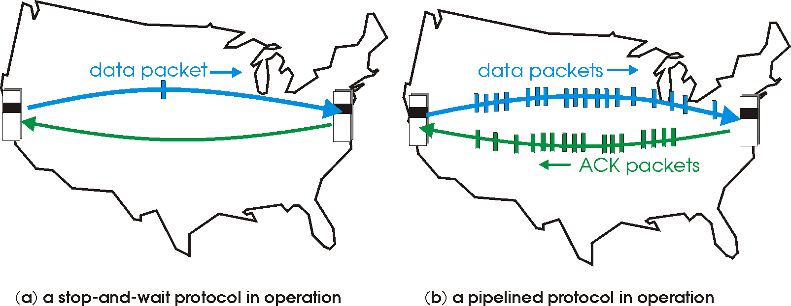
Pipelined protocols
pipelining: sender allows multiple, “in-flight”, yet-to- be-acknowledged pkts
range of sequence numbers must be increased
buffering at sender and/or receiver
two generic forms of pipelined protocols: go-Back-N,
selective repeat

Slide 45



Pipelining: increased utilization
sender receiver
first packet bit transmitted, t = 0 last bit transmitted, t = L / R
first packet bit arrives
last packet bit arrives, send ACK
last bit of 2nd packet arrives, send ACK last bit of 3rd packet arrives, send ACK
RTT
ACK arrives, send next packet, t = RTT + L / R
Increase utilization by a factor of 3!
U
3 * L / R RTT + L / R
.024
sender⁼
=
=
0.0008
30.008
How many packets should be in the pipeline?

Slide 46
Bandwidth-Delay Product (BDP)
A logical link has a bandwidth of B bits/s and the round trip time is D sec.
Bandwidth-Delay Product or BDP is computed as B*D
Example:
Two computers are connected over a WAN and can transfer data at 2Mbps with 100ms round trip time
▪ BDP = 2 * 0.1 = 0.2 Mb
A satellite link has a bandwidth of 10Mbps and RTT of 1s
▪ BDP = 10 * 1 = 2 Mb
Two computers from two universities in different continents are connected by a 500Mps link and has RTT of 200ms
• BDP = 500 * 0.2 = 100 Mb

Slide 47
BDP Computation (cont’d)
How do you interpret BDP?
Why is BDP interesting?
BDP estimates on the amount of data that the
communicate pipe can “store”
If the amount of unack data (window size) allowed is less than the BDP, sender will be idle at times, leading to lower efficiency

Slide 48
Pipelined Protocols
Selective Repeat: big pic
sender can have up to N unack’ed packets in pipeline
rcvr sends individual ack for each packet
sender maintains timer for each unacked packet
when timer expires, retransmit only unack’ed packet
Go-back-N: big picture:
sender can have up to N unacked packets in pipeline
rcvr only sends
cumulative acks
doesn’t ack packet if
there’s a gap
sender has timer for oldest unacked packet
if timer expires, retransmit all unack’ed packets

Slide 49
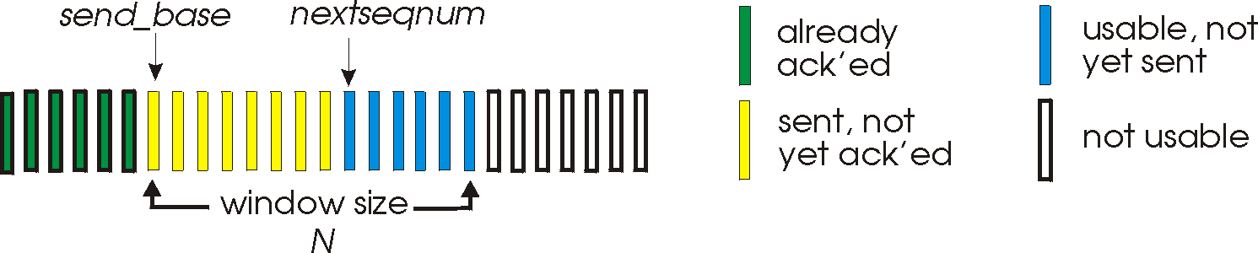
Go-Back-N
Sender:
k-bit seq # in pkt header
“window” of up to N, consecutive unack’ed pkts allowed
ACK(n): ACKs all pkts up to, including seq # n - “cumulative ACK”
may receive duplicate ACKs (see receiver)
timer for each in-flight pkt
timeout(n): retransmit pkt n and all higher seq # pkts in window

Slide 50
Go-Back-N
sender window (N=4)
sender
receiver
0 1 2 3 4 5 6 7 8
send pkt0
send pkt1
send pkt2
send pkt3
(wait)
0 1 2 3 4 5 6 7 8
receive pkt0, send ack0
receive pkt1, send ack1
receive pkt3, discard,
(re)send ack1
0 1 2 3 4 5 6 7 8
X
0 1 2 3 4 5 6 7 8
loss
0 1 2 3 4 5 6 7 8
rcv ack0, send pkt4
rcv ack1, send pkt5
0 1 2 3 4 5 6 7 8
receive pkt4, discard,
(re)send ack1
ignore duplicate ACK
receive pkt5, discard,
(re)send ack1
pkt 2 timeout
0 1 2 3 4 5 6 7 8
send pkt2
send pkt3
send pkt4
send pkt5
0 1 2 3 4 5 6 7 8
0 1 2 3 4 5 6 7 8
rcv pkt2, deliver, send ack2
rcv pkt3, deliver, send ack3
rcv pkt4, deliver, send ack4
rcv pkt5, deliver, send ack5
0 1 2 3 4 5 6 7 8

Slide 51
Selective Repeat
receiver individually acknowledges all correctly received pkts
buffers pkts, as needed, for eventual in-order delivery to upper layer
sender only resends pkts for which ACK not received
sender timer for each unACKed pkt
sender window
N consecutive seq #’s
again limits seq #s of sent, unACK’ed pkts

